Slide 1
Myers-Briggs Type Indicator (MBTI)
AZAD SINGH S 6/03/2023
Tensile tech

Slide 2
AGENDA
Introduction
Indicators
Personality types

Slide 3
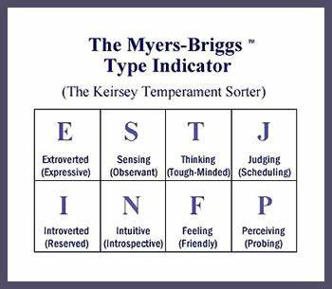
INTRODUCTION
The Myers-Briggs Personality Type Indicator is a self- report inventory designed to identify a person's personality type, strengths, and preferences.

Slide 4
INDICATORS
Extraversion (E) – Introversion (I)
Sensing (S) – Intuition (N)
Thinking (T) – Feeling (F)
Judging (J) – Perceiving (P)

Slide 5
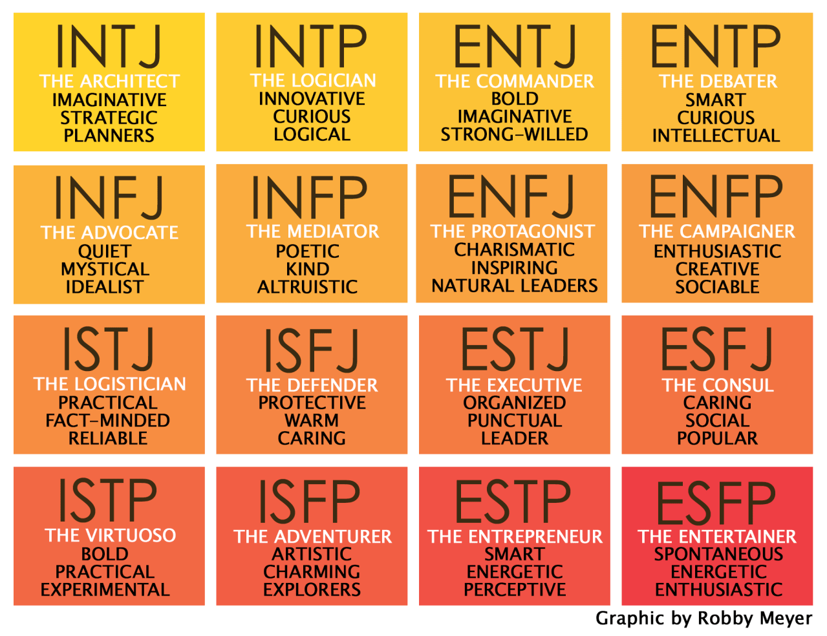
The Myers Briggs Types

Slide 6
THANK YOU

